Slide 1

Decision Theory Part II (pt 2)
Chris Kiekintveld

Slide 2
Prospect Theory
Descriptive theory developed to model how humans make decisions more accurately that expected utility theory
Kahneman and Tversky, 1979
Nobel prize, seminal work in behavioral economics
Predicts some regularities in behavioral data
Many followup developments (e.g., cumulative prospect theory)

Slide 3
Prospect Theory: Editing
Phase I: “Editing”
Tries to account for how people frame a decision
Many framing effects in psychology
Identify gains/losses, group similar items
Eliminate dominated items
Identify a reference point
Often current state; not always
Gains/losses treated differently

Slide 4
Prospect Theory: Evaluation
Phase II: Evaluation
Process of selecting the choice with the highest value
Combines values and likelihoods; similar to expected utility in this sense
Both value and probability functions are passed through functions that alter the objective values into perceived values
Flexible model, but functions have typical forms

Slide 5
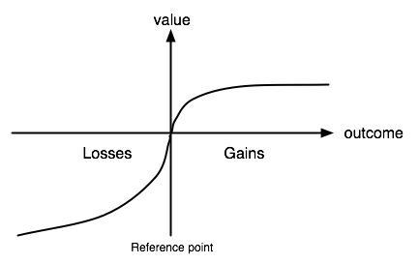
Prospect Theory: Value Function
Modifies perceived value
Reference point!
Concave for gains, convex for losses
Steeper for losses than gains

Slide 6
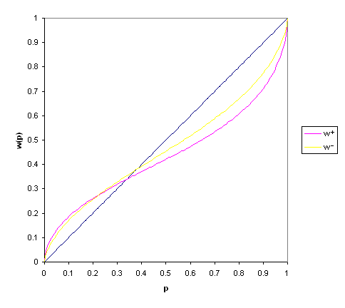
Prospect Theory: Decision Weight
Modifies objective probabilities
Does not follow probability axioms
Overweighting of
small probabilities
and very large ones
Can capture risk aversion
and risk seeking

Slide 7
Sensitivity Analysis
In many (all?) decisions there is some uncertainty about the parameters
What if some parameters are wrong?
Does it change the decision? The value?
How much can we change each parameter without changing the optimal decision?
Sensitivity analysis aims to determine how robust a decision is to changes in parameters

Slide 8
Portfolio Theory
Often, you can choose multiple options
Allocating assets across a portfolio
Randomizing an action choice across many similar decisions
Why might this be a good idea?
In a security context?

Slide 9
Portfolio Example
Expected
Utility
Worst
Case
Likelihood:
0.3
0.4
0.3
Security Investment/Threat | Malware | DDOS | Spear Phishing
IDS | -1000 | -2000 | -10,000
Employee Training | -2000 | -10,000 | -1000
50/50 Mix | -1,500 | -6000 | -5500
-4100
-10000
-4900
-10000
-4500
-6000

Slide 10
Key Principles
Diversification reduces risk/variance
Want assets/choices that are not correlated
When one does well, the other does poorly
All selections should have similar (high) expected values
Including lower values reduces performance
Tradeoff between risk and average case
Portfolio design is the problem of constructing efficient portfolio allocations

Slide 11
80/20 Rule
Diminishing marginal returns
Each additional unit gives a smaller amount of value than the previous one
Natural in many types of investments
80/20 rule is a heuristic version of this
Makes designing a portfolio over many options even more compelling!

